Slide 1

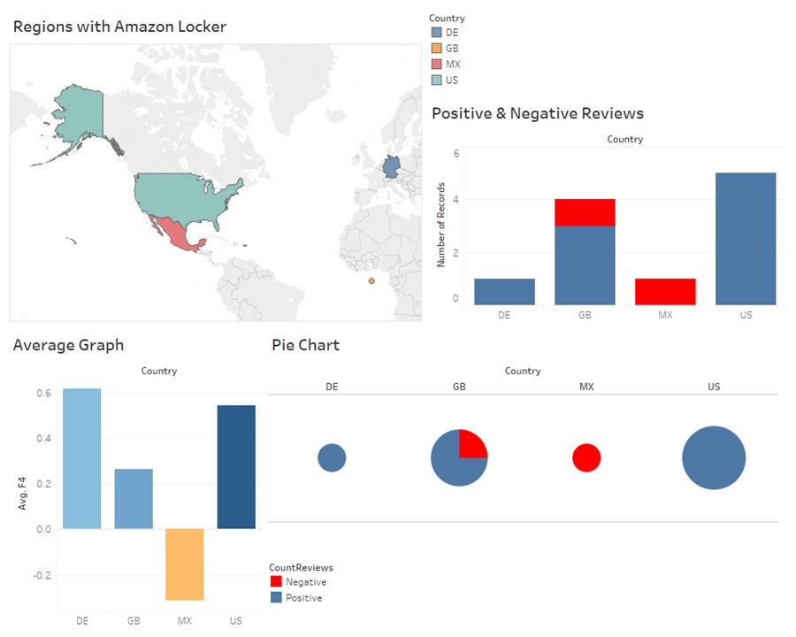

Access point experience dashboard

Slide 2
Problem statement
To collect feedbacks posted by customers on social media platforms about access points (pickup points/stores, Amazon lockers and hubs) and create an Experience Dashboard to understand customer requirements and experience with above mentioned access points in different countries.

Slide 3
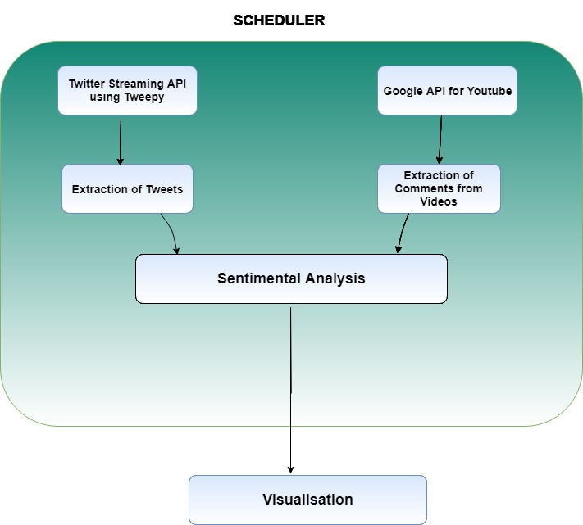
How it works?
Technical solution details

Slide 4



Key challenges
Limited API quota
API may be down.
Youtube API can be requested limited number of times
Only previous 7 days data returned by Twitter API
Limited feedback options
Handle special characters
Facebook API is not free to use
Quora, and reddit don’t have relevant data
Emojis, Non alphanumeric
Non English characters (Eg. Greek, Latin etc)

Slide 5

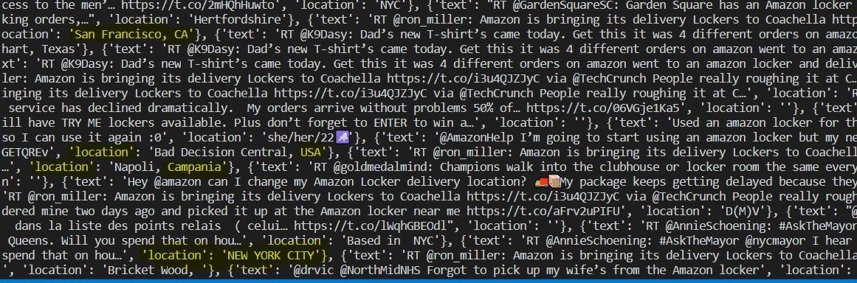

Data extraction - Youtube
CommentThreads
Fetching
Modified/deleted comments

Slide 6
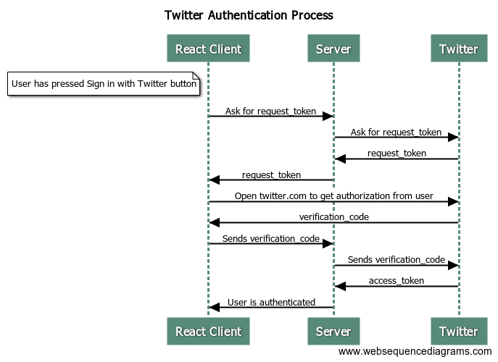

Data extraction - Twitter
Authentication
Fetching
Removal of extra characters and HTML tags

Slide 7

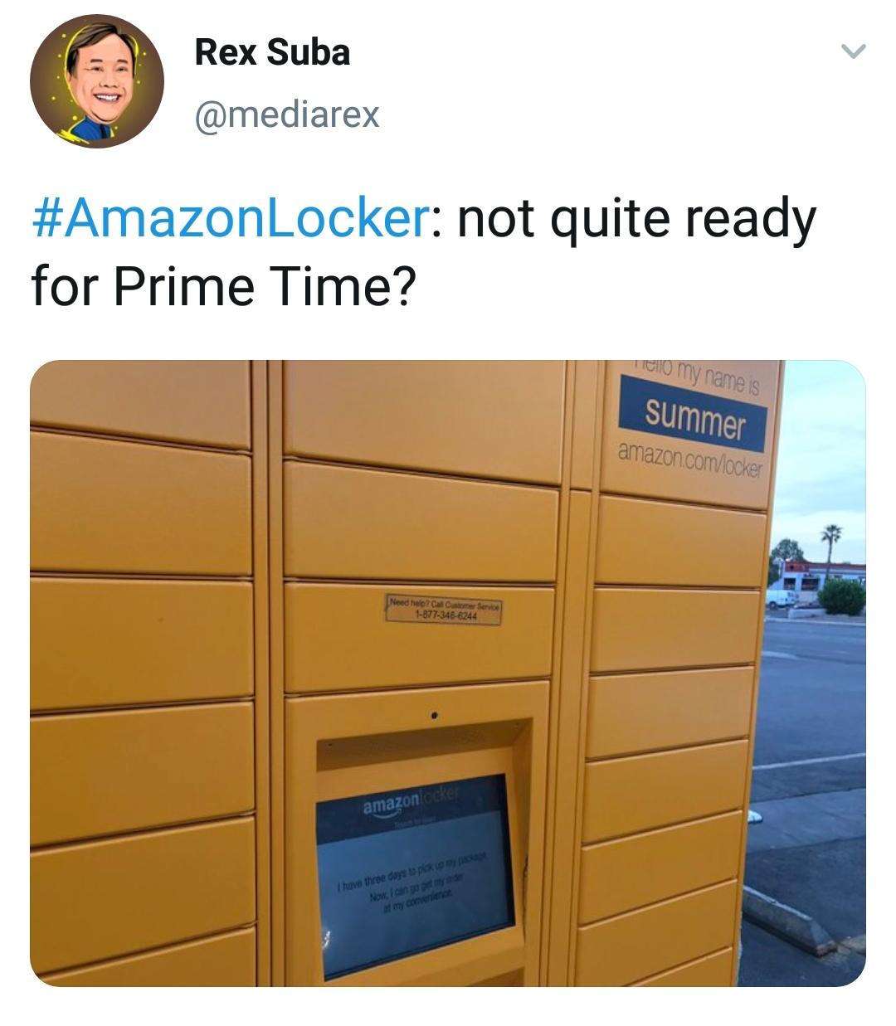



Sentimental analysis
Use emoticons, emojis
Use tricky sentences
Use acronyms
Typical negations

Slide 8
Sentimental analysis - Vader
Detect and translate emojis
Trained on datasets of social media, Amazon reviews
Sentiments metric
Compound - single unidimensional measure of sentiment for a given sentence [ -1,1 ]
Proportion of text
Positive
Negative
Neutral

Slide 9
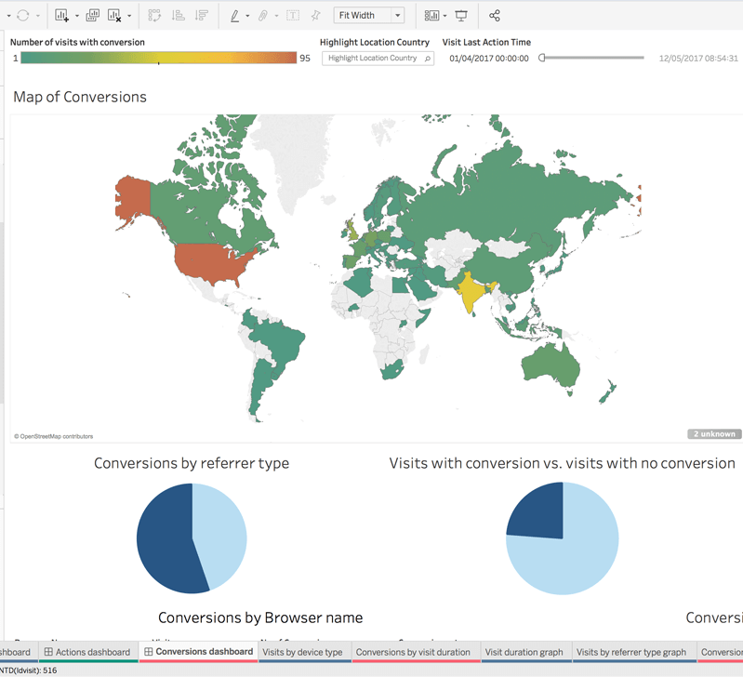
Data visualization - Tableau
Why Tableau?
Drag and drop to create visualizations even for large data
Appealing data representation like geographical maps
Graph reflect dynamic data change
Comprehensive reports
User friendly interface
Export dashboard and share with a click

Slide 10
Future scope/Improvements
Use paid API of Twitter
Use Dynamic Database
Optimise use of API
Amazon feedback platform for its services

Slide 11
Thankyou

